Slide 1
Financial Aid and Billing Overview
WABASH 101
JUNE 18, 21, 22, 26

Slide 2
AID APPLICATION PROCESS
Complete the Free Application for Federal Student Aid (FAFSA) Available October 1
  FAFSA is used to determine federal, state, and institutional need-based eligibility, including loan and work eligibility for the student
  The annual filing deadline for returning students is February 1

Slide 3
TWO TYPES OF AID
Merit-based Aid
  Awarded by Admissions Office during admissions process
  Based on high school GPA and ACT/SAT scores
  Renewable provided student is allowed to stay at the College by Dean (i.e. no minimum GPA requirement)
  Available for 8 semesters

Slide 4
TWO TYPES OF AID
Need-based (grants & self-help)
  Awarded by Financial Aid Office annually
  Based on demonstrated need for financial assistance as determined by the FAFSA application annually
    Renewal Eligibility depends on continuing to demonstrate:
      Financial need (meeting application/verification deadlines)
      Satisfactory academic progress (SAP)
      Campus citizenship (as determined by DoS)

Slide 5
STATE GRANT PROGRAMS
Indiana Freedom of Choice Grant (up to $9,000)
Evan Bayh 21st Century Scholarship ($8,395)
FAFSA is the “application”
  Must be full-time (min. 3 Wabash course credits per semester)
  Available for 8 semesters
  FAFSA must be received by the federal processor on or before April 15 each year
  Must demonstrate need each year

Slide 6
IN STATE GRANT RENEWAL REQUIREMENTS
Recipients of the Indiana Freedom of Choice Award must complete the following number of credits in order to partially renew their state grant eligibility:
Recipients of the Indiana Freedom of Choice Award and the Evan Bayh 21st Century Scholarship must complete the following number of credits in order to fully renew their state grant eligibility:
End of first academic year | 6.0
End of second academic year | 12.0
End of third academic year | 18.0
End of first academic year | 7.5
End of second academic year | 15.0
End of third academic year | 22.5

Slide 7
IN STATE GRANT RENEWAL REQUIREMENTS
Applies to all students who receive state financial aid
Academic year for Indiana state grant purposes is defined as 12 months from the time the student first enrolls

Slide 8
SATISFACTORY ACADEMIC PROGRESS
Federal regulations require that all student financial aid recipients make satisfactory academic progress (SAP) toward graduation.
Three SAP standards to maintain eligibility to receive federal, state, and institutional financial aid
      Qualitative (grades)
      Quantitative (pace of progression)
      Maximum Timeframe
All 3 standards are measured at the end of each semester

Slide 9
VERIFICATION
IF you are selected for verification, you will be contacted by the Financial Aid Office via a letter mailed to the home address or an email to check your Self-Service.
You will need to:
  Submit all Verification forms, documents, and worksheets directly to the Financial Aid Office.
  Aid package will remain estimated until all Verification documents received
    Returning students do not receive an aid package until all verification documents are received
  Will receive a REVISED Financial Aid Award Letter by email if aid package changes due to Verification

Slide 10
MISSING INFORMATION LETTER

Slide 11
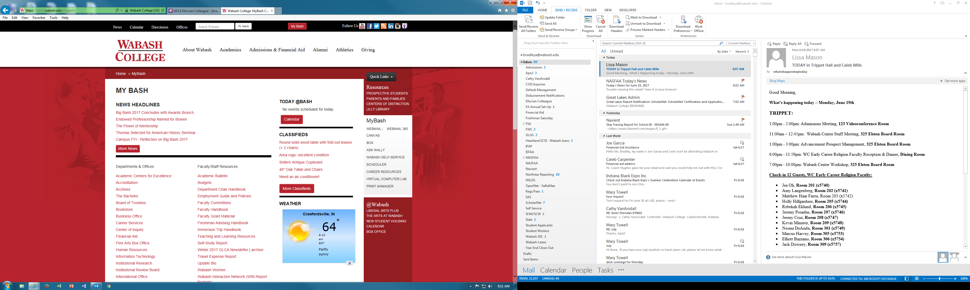
WABASH SELF-SERVICE

Slide 12
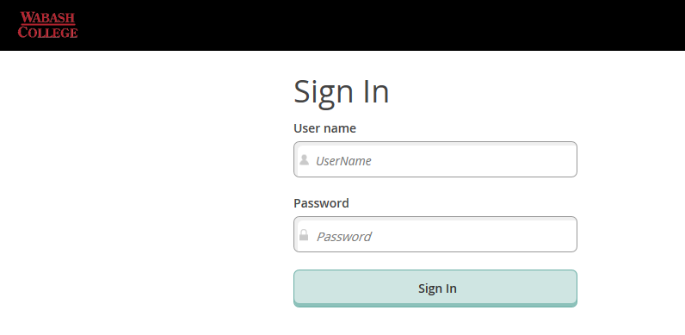
WABASH SELF-SERVICE LOGIN

Slide 13
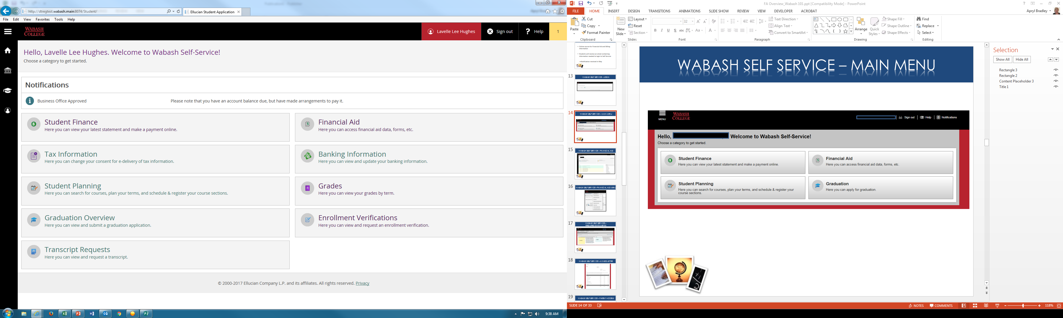
WABASH SELF-SERVICE
MAIN MENU

Slide 14
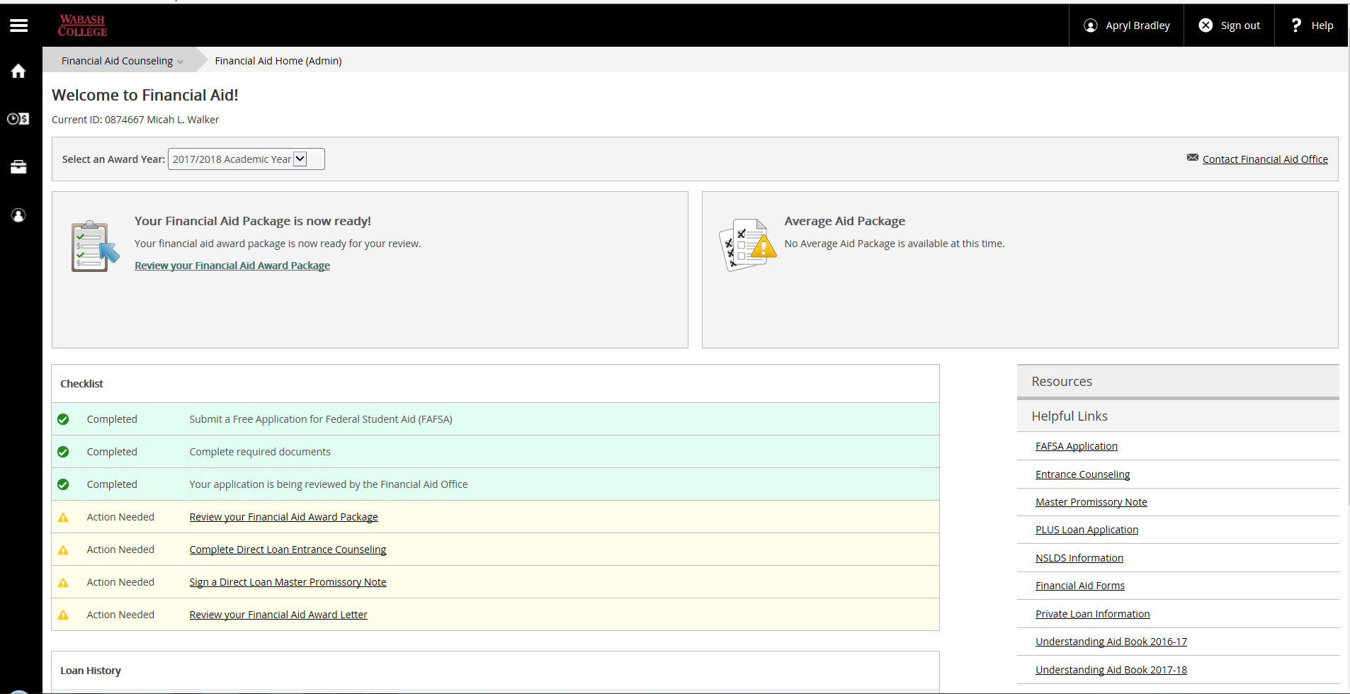
WABASH SELF-SERVICE
FINANCIAL AID

Slide 15
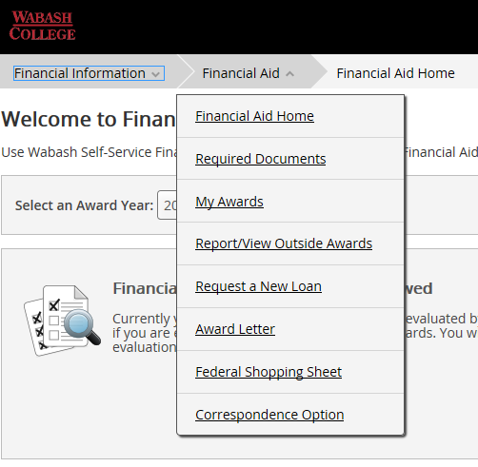
WABASH SELF-SERVICE
FINANCIAL AID MENU

Slide 16
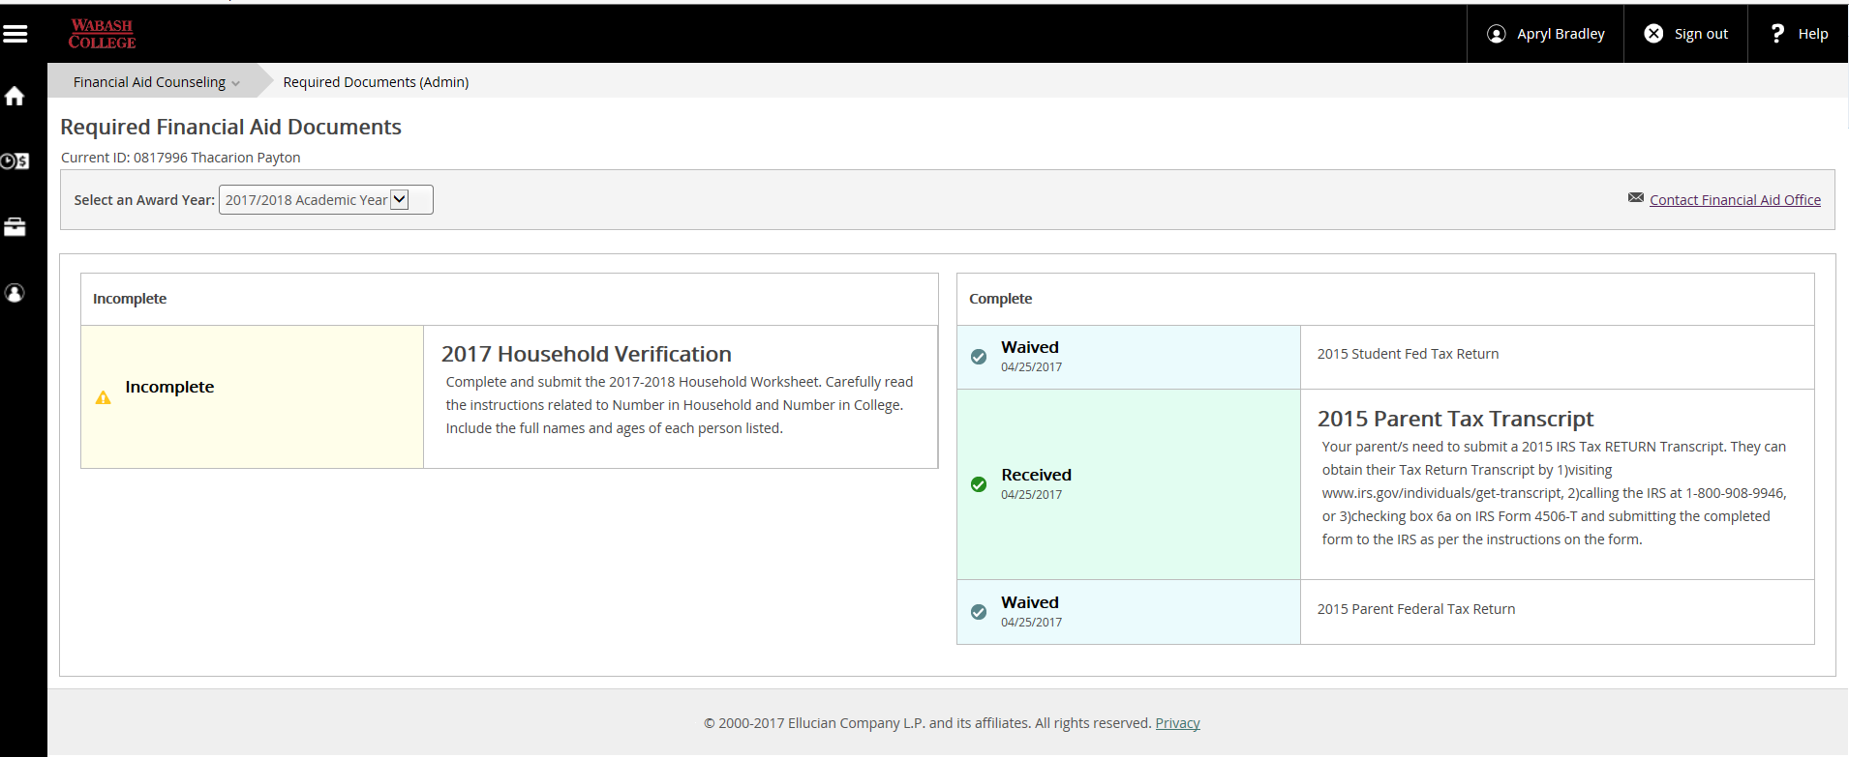
WABASH SELF-SERVICE
REQUIRED DOCUMENTS

Slide 17
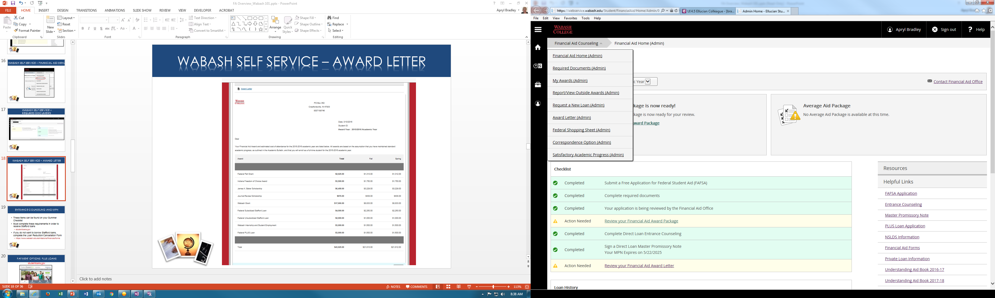
WABASH SELF-SERVICE
AWARD LETTER

Slide 18
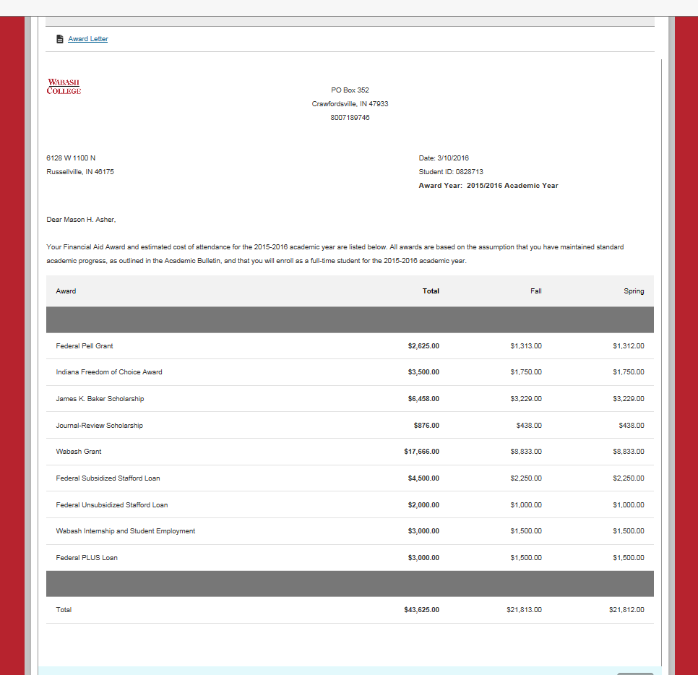
WABASH SELF-SERVICE
AWARD LETTER

Slide 19
FEDERAL STUDENT LOANS
ENTRANCE COUNSELING & MPN
These items can be found on your
NEW STUDENT ROAD MAP
Must complete in order to receive Stafford loans
  https://studentloans.gov/myDirectLoan/index.action
If you do not want to utilize Stafford loans, complete the
Loan Reduction/Cancellation Form
  https://www.wabash.edu/admissions/finances/forms

Slide 20
PAYMENT OPTIONS
PARENT PLUS LOAN
  Eligibility to borrow PLUS loans (Parent Loan for Undergraduate Students):
Borrower must be a U.S. Citizen or National or Permanent Resident/Other Eligible Non-Citizen
Borrower must be the biological or adoptive parent of the student, or
Borrower must be the spouse of the student's parent and considered to be a parent in accordance with the instructions on the Free Application for Federal Student Aid (FAFSA) for purposes of reporting income and assets on the FAFSA

Slide 21
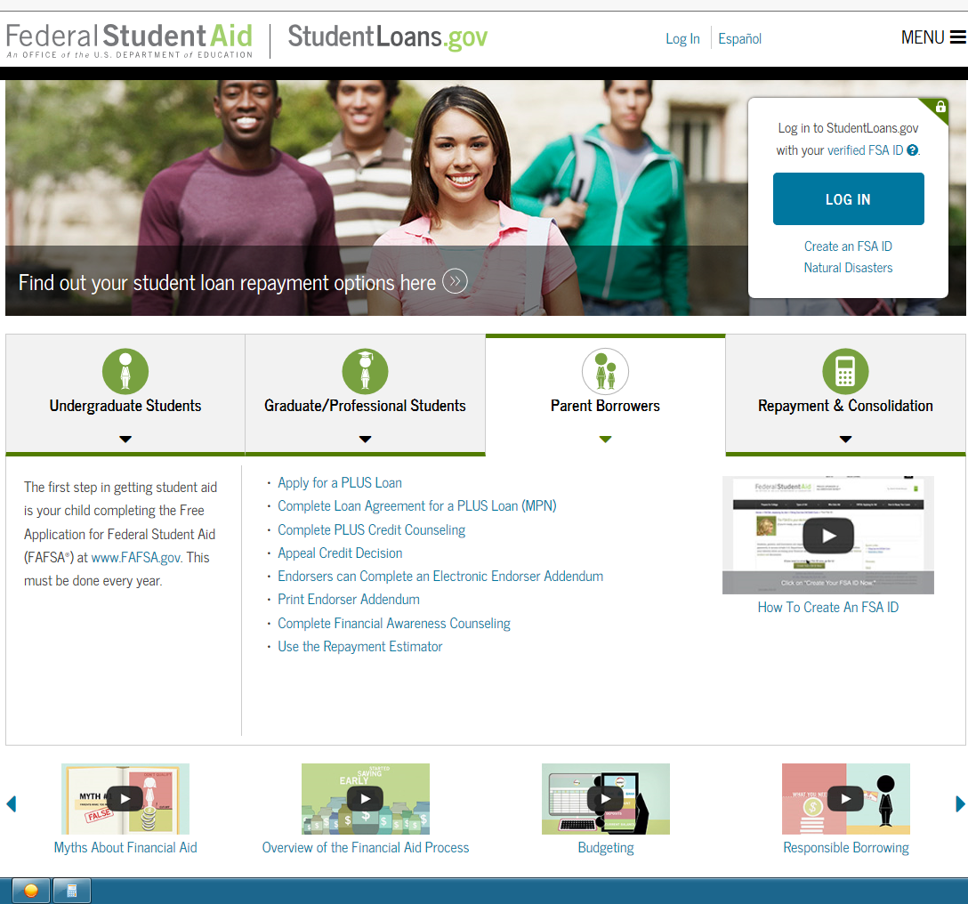
PAYMENT OPTIONS
PARENT PLUS LOAN

Slide 22
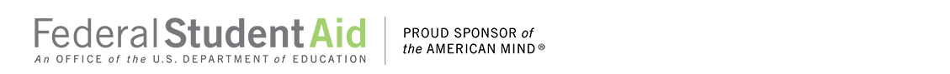
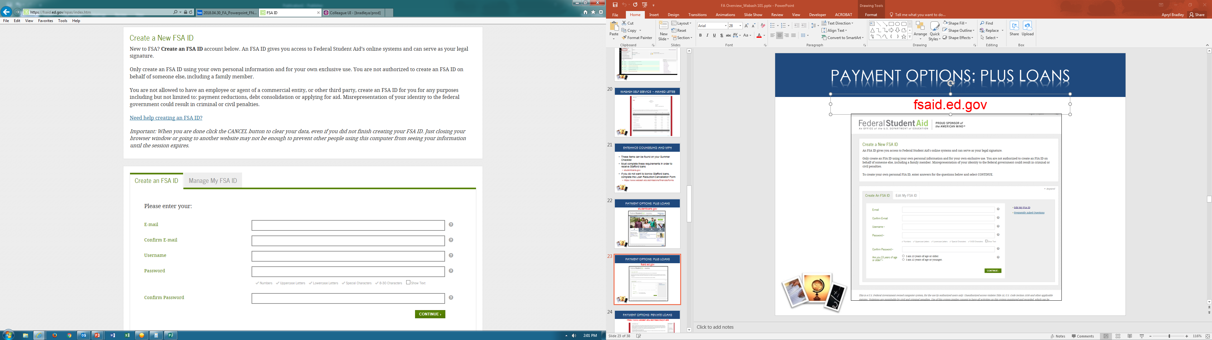
PAYMENT OPTIONS
PARENT PLUS LOAN
https://fsaid.ed.gov/npas/index.htm

Slide 23
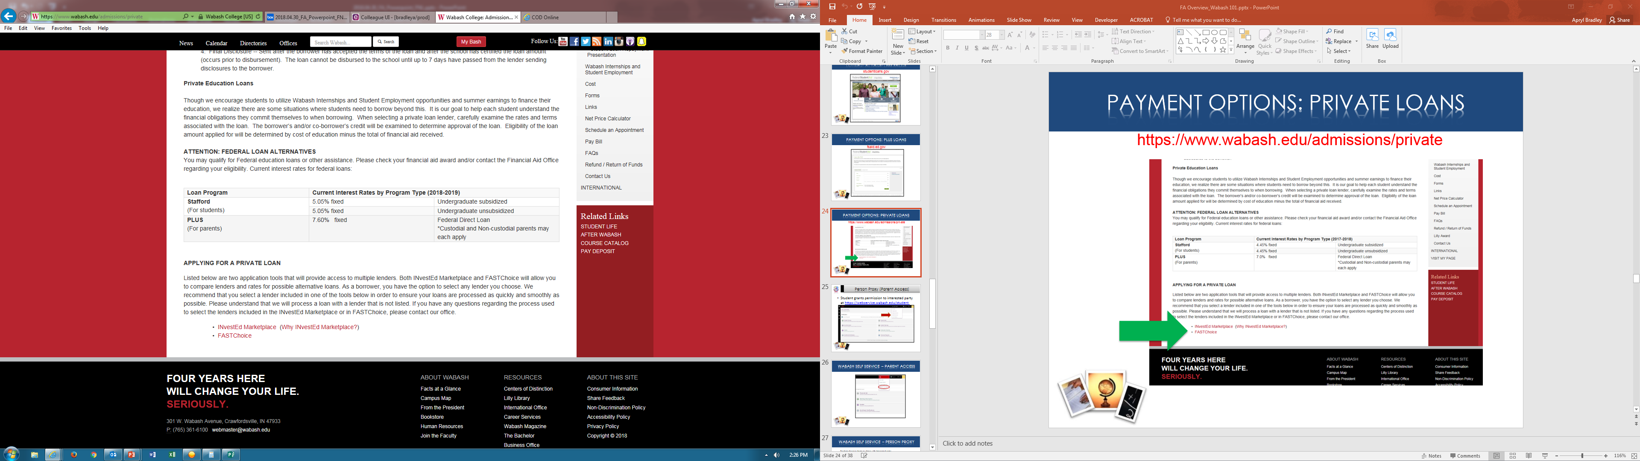
PAYMENT OPTIONS
PRIVATE ALTERNATIVE LOANS

Slide 24
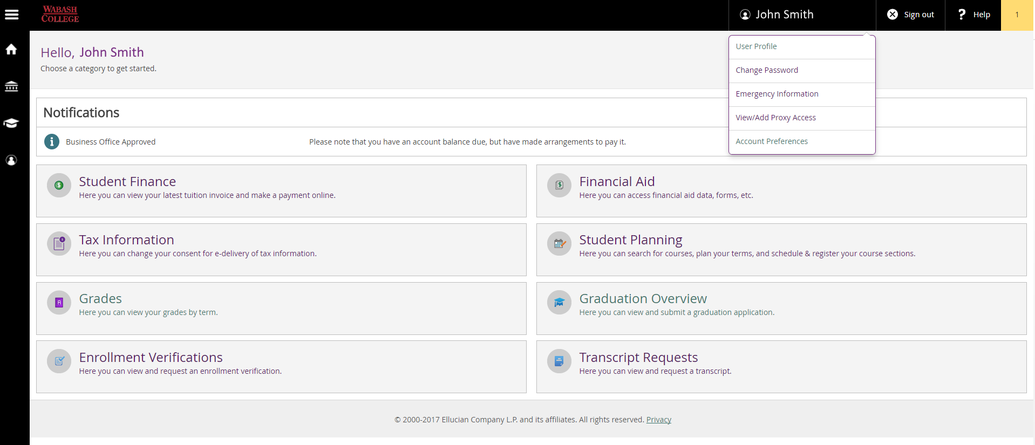
Parent Access to Tuition Invoice
*Person Proxy*
Student grants permission to interested party at https://webservice.wabash.edu/student

Slide 25
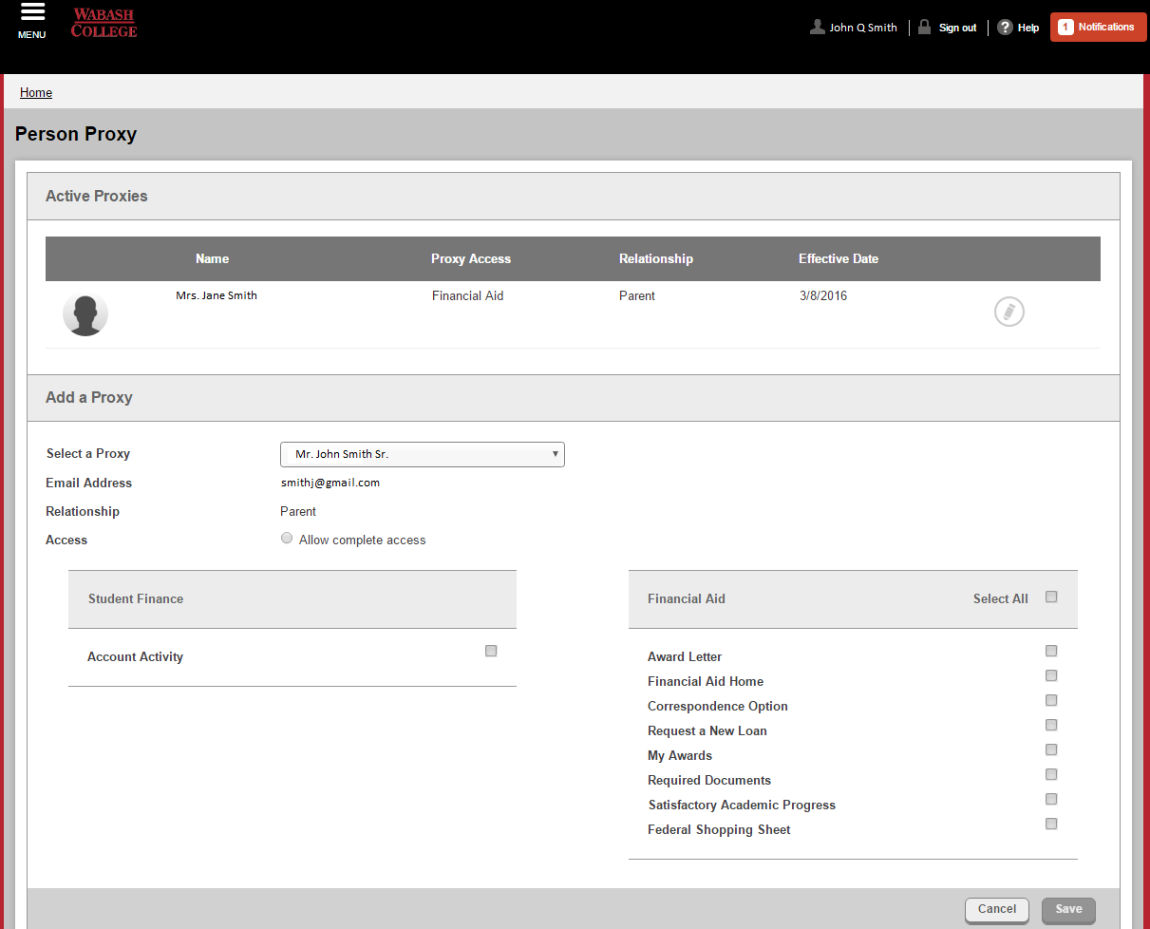
Person Proxy
Student chooses items to share with interested parties.

Slide 26
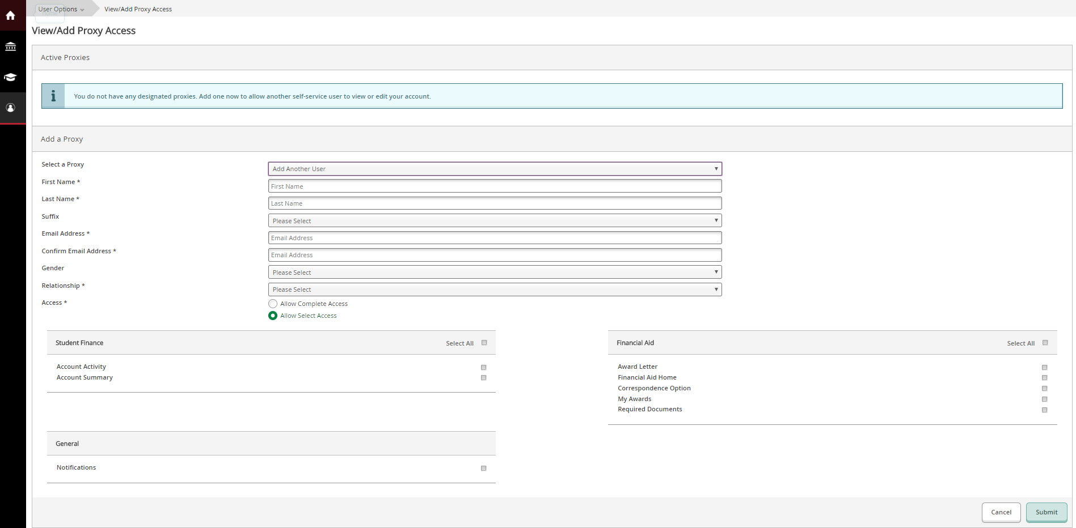
Person Proxy
Choose or Add User

Slide 27
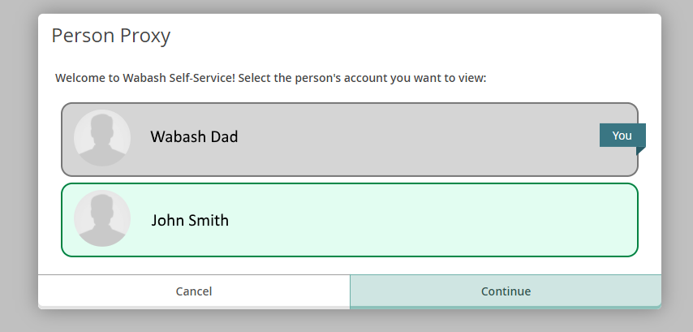
Person Proxy
Authorized User receives emails with User ID and Password.
Authorized User logs in to Self Service, changes password, then chooses STUDENT to view financial information.

Slide 28
Access to Tuition Invoice
Wabash Self-Service – Main Menu

Slide 29
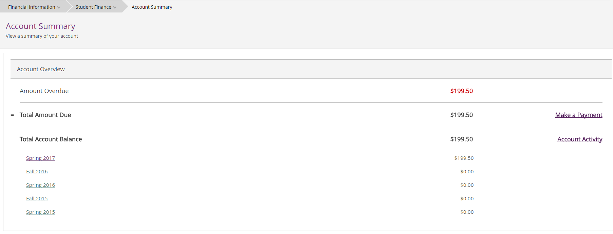
Student Finance Home Screen
Account Summary

Slide 30
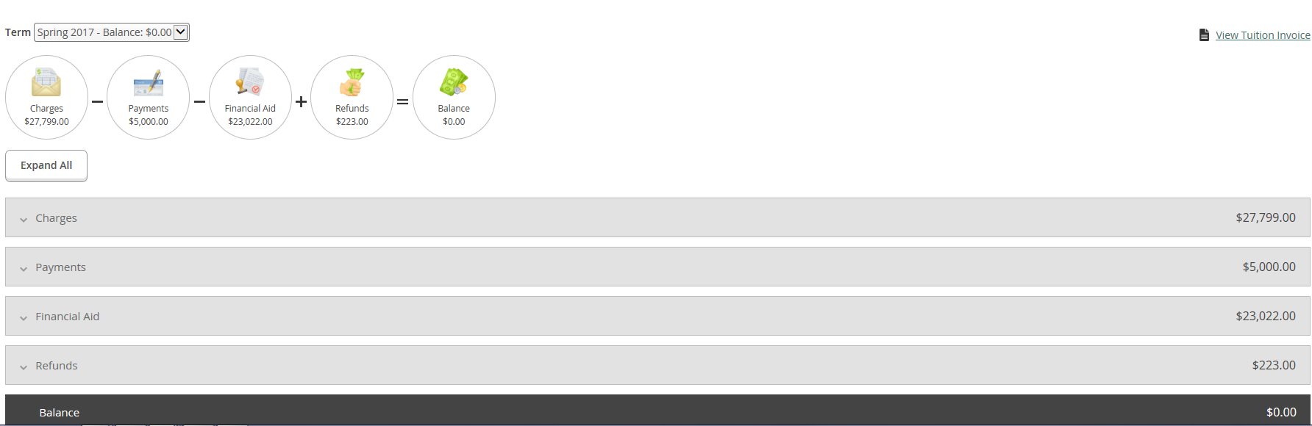
Student Finance
Semester Summary

Slide 31
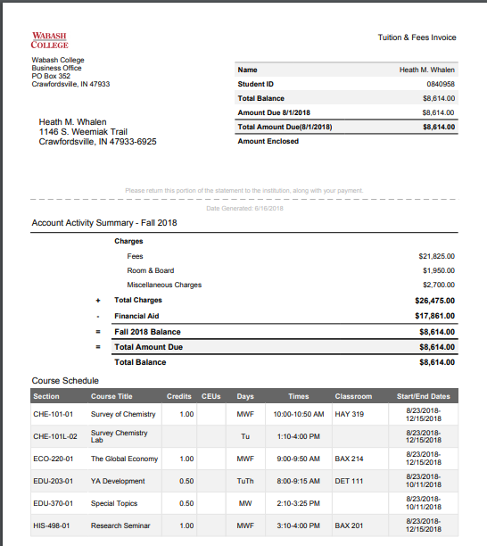
Tuition Invoice
Summary
By Semester

Slide 32
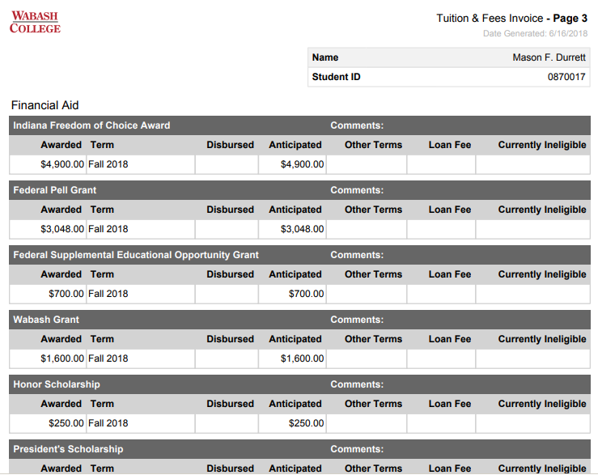
Tuition Invoice
Financial Aid
Detail of financial aid applied to tuition invoice

Slide 33
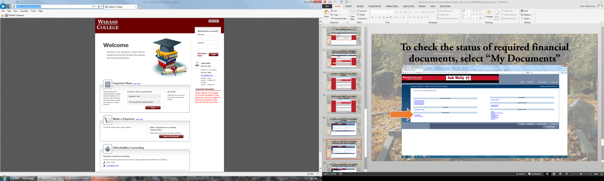
Payment Plan
www.afford.com/wabash

Slide 34
Payment Plan
Calculate Budget
(include any outside scholarships you are aware of)

Slide 35
Time for Q & A
Financial aid and billing overview

